Slide 1

School of Mechanical Engineering
Course Code: BME01T1001 Course Name: Engineering Graphics and Introduction to Digital Fabrication
Projection of Points
Faculty Name: Mr. Anurag Shanu Program Name: B.Tech First Year

Slide 2
Prerequisite/Recapitulations
Basics of Engineering Graphics
Drawing, Sketching

Slide 3
Objectives
To acquire knowledge about:
Introduction to Projection
Different views and Notation
Convention used in drawing
Point
Projection of Point in different plane

Slide 4
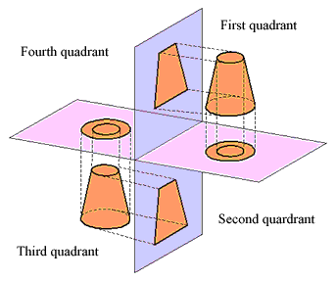
First Angle vs. Third Angle Projection
1ST ANGLE OF PROJECTION | 3RD ANGLE OF PROJECTION
The object is kept in the 1st quadrant. The object lies in between the observer & the Plane of projection The plane of projection is assumed to be Non-transparent In this method, when the views are drawn in their relative position, the plan comes below the FV/elevation or the TV drawn below the FV. The left side view is drawn to the right side of the FV. The right side view is drawn to the left side of the FV. This method of projection is used In European Countries & bureau of Indian standard is adopted w.e.f. 1981. | The object is assumed to keep in 3rd quadrant. The plane of projection lies between the observer and the object. The plane of projection is assumed to be transparent In this method, when the views are drawn in their relative position, the plan comes above the elevation or TV is drawn above the FV. The left side view is drawn to the left side of the FV. The right side view is drawn to the right side Of the FV. This method of projection is used In U.S.A & other countries

Slide 5

Introduction

Slide 6
Different Views & Notations
2nd Quadrant
VP
2nd Quad.
1ST Quad.
F.V.
1st Quadrant
Y
X Y
HP
X
3rdQuadrant
Observer
3rd Quad.
4th Quad.
4th Quadrant

Slide 7
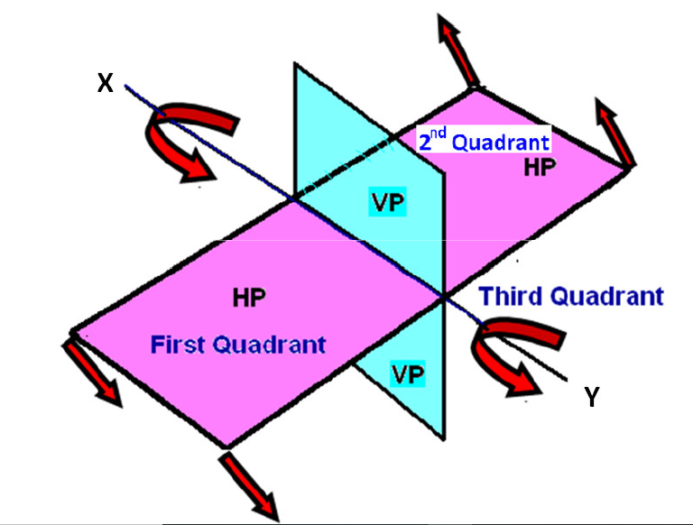
Direction of rotation of the HP
Convention:
Horizontal plane is always rotated clockwise

Slide 8
Convention
OBJECT POINT A LINE AB
Top views are represented by only small letters e.g. a
Their front views are conventionally represented by
small letters with dashes e.g. a’
Profile or side views are represented by small letters
with double dashes e.g. a’’
IT’S TOP VIEW a a b
IT’S FRONT VIEW a’ a’ b’
IT’S SIDE VIEW a” a” b”
Notes:
Top views are represented by only small letters eg. a.
• Their front views are conventionally represented by
small letters with dashes eg. a
• Profile or side views are represented by small letters
with double dashes eg. a

Slide 9
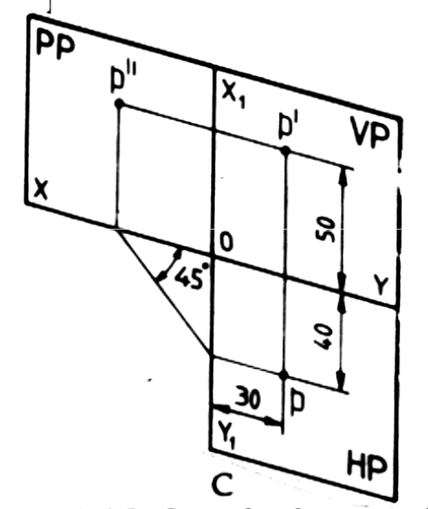
Convention
The line of
intersection of HP and
VP is denoted as XY.
The line of
intersection of VP and
PP is denoted as X1Y1
Notes:
Top views are represented by only small letters eg. a.
• Their front views are conventionally represented by
small letters with dashes eg. a
• Profile or side views are represented by small letters
with double dashes eg. a

Slide 10
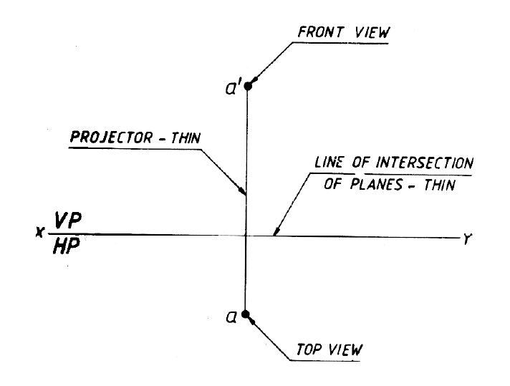
Convention
Projectors and the lines of the intersection of planes
of projections are shown as thin lines.

Slide 11
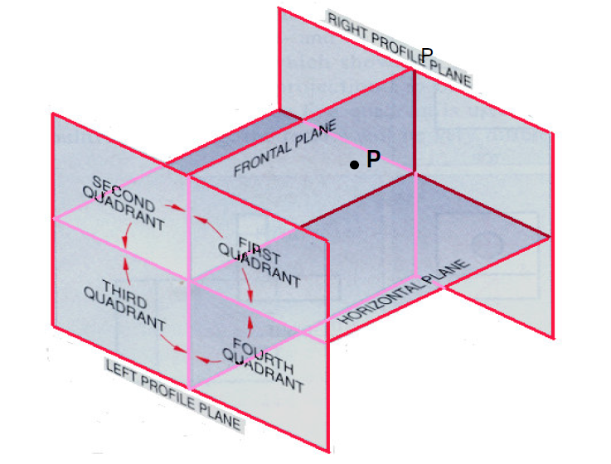
Point
Define its position with respect to the coordinates.
With respect to the VP, HP, & PP

Slide 12
Projection of a Point
Point A is
Placed In
different
quadrants
and it’s Fv & Tv
are brought in
same plane for
Observer to see
clearly.
Fv is visible as
it is a view on
VP. But as Tv is
is a view on Hp,
it is rotated
downward 90⁰,
In clockwise
direction.The
In front part of
Hp comes below
xy line and the
part behind Vp
comes above.
Observe and
note the
process.
POINT A IN
2ND QUADRANT
VP
POINT A IN
1ST QUADRANT
VP
a’
A
A
a’
a
Point in different quadrants
HP
OBSERVER
HP
OBSERVER
a
a
HP
HP
OBSERVER
OBSERVER
a’
a
A
a’
POINT A IN
3RD QUADRANT
A
POINT A IN
4TH QUADRANT
VP
VP

Slide 13
Projection of a Point in first quadrant
POINT A ABOVE HP
& INFRONT OF VP
POINT A ABOVE HP
& IN VP
POINT A IN HP
& INFRONT OF VP
For Tv
For Tv
Projection in first quadrant
PICTORIAL
PRESENTATION
PICTORIAL
PRESENTATION
a’
a’
A
For Fv
For Tv
A
Y
Y
Y
For Fv
a
a’
X
X
a
a
X
A
ORTHOGRAPHIC PRESENTATIONS
OF ALL ABOVE CASES.
For Fv
Fv above xy,
Tv below xy.
Fv above xy,
Tv on xy.
Fv on xy,
Tv below xy.
VP
VP
VP
a’
a’
X
Y
X
a
Y
X
a’
Y
a
a
HP
HP
HP

Slide 14
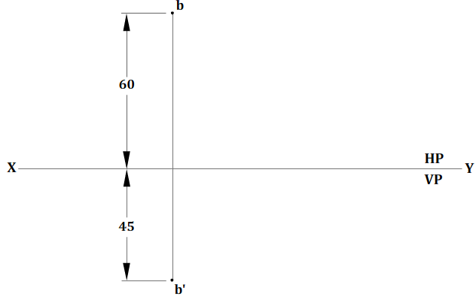
Exercise
PROBLEM NO.01:-
Q.) A point B is 45 mm below HP and 60 mm behind VP. Draw the projections of the point.

Slide 15
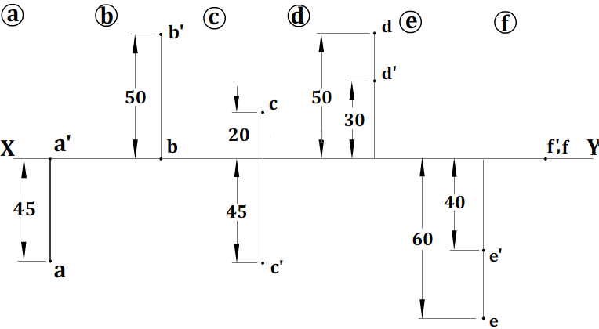
Practice Question
PROBLEM NO.02:-
Q.) Draw the projections of the following points on a common reference line (x y)
Point A on HP and 45 mm in front of VP.
Point B in VP and 50 mm above HP.
Point C 45 mm below HP and 20 mm behind VP.
Point D 30 mm above HP and 50 mm behind VP.
Point E 40 mm below HP and 60 mm in front of VP.
Point F on HP and in VP

Slide 16
Summary
A point is defined as a geometrical element that has no dimension. In engineering drawing the point is represented as a very small circle or a dot.
Or, a point is represents a location in space or on a drawing & has no width, height or depth.
A point is simple & simple entity denoted by capital alphabets (A, B, C… Z)
Its front view is denoted by a’
Its top view is denoted by a

Slide 17
Questions
What are the notations used in denoting the projection of point?
A point A is 20 mm above HP and 30 mm in front of VP. Draw its projections
A point D is 20 mm below HP and 30 mm in front of VP. Draw its projections.
Draw the projections of the following points on the same ground line, keeping the distance between projectors equal to 25 mm. (i) Point A, 20 mm above HP, 25 mm behind VP; (ii) Point B, 25 mm below HP, 20 mm behind VP; (iii) Point C, 20 mm below HP, 30 mm in front of VP; (iv) Point D, 20 mm above HP, 25 mm in front of VP; (v) Point E, on HP, 25 mm behind VP; (vi) Point F, on VP, 30 mm above HP

Slide 18
References
Engineering Drawing by N. D. Bhatt and V. M. Panchal
Engineering Graphics by K. C. John
NPTEL

Slide 19
Thank You

